Slide 1
Protest Analysis for Guiding Public Policy
DAB 201 – Winter 2020
Vignesh Sridhar Athreya
Parniyan Darakhshan
Kenneth Hudak
Siddhesh Dwarkanath Munagekar
“Those who make peaceful revolution impossible will make violent revolution inevitable.“
-John F. Kennedy

Slide 2
Background
Protests have a profound impact on social and economic balances within a community. Our analysis will show insights to the global distribution of social movements, and perhaps where policy makers should best focus their attention in the future.
Using Data provided by The Mass Mobilization Project, the following visualizations are an effort to understand citizen movements against governments, what citizens want when they demonstrate against governments, and how governments respond to citizens. The data cover 162 countries between 1990 and 2018 and is sponsored by the Political Instability Task Force (PITF) with funding from the US Central Intelligence Agency (CIA).

Slide 3
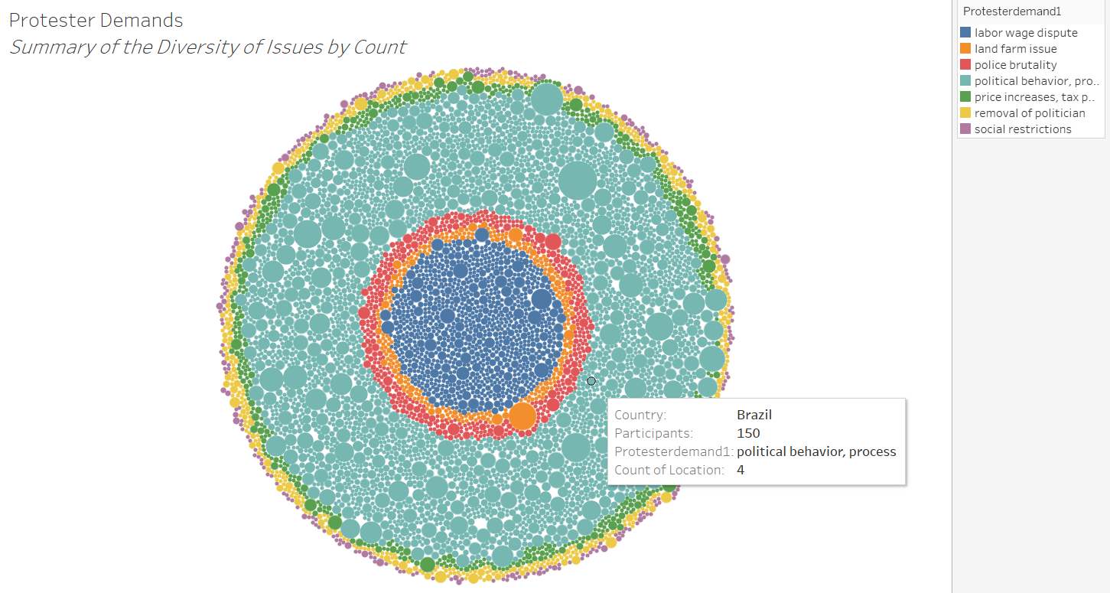
Social Movements Occur Around the Globe
Protests span all countries and a variety of struggles against exploitation. Seven of the most common causes are exhibited above. Here, we see the most numerous individual events occurred because of objection to political process: which includes choices made by leaders that influence a range of political outcomes from elections & domestic subsidies to foreign policy.

Slide 4
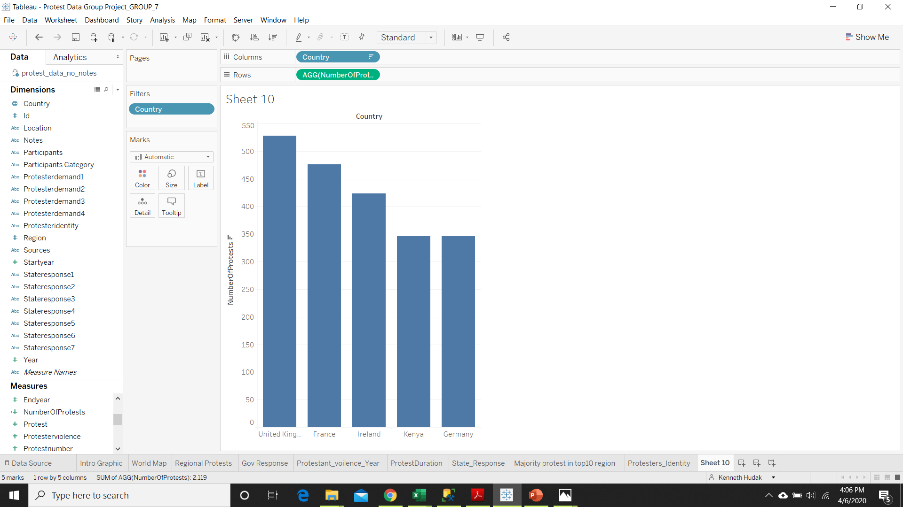
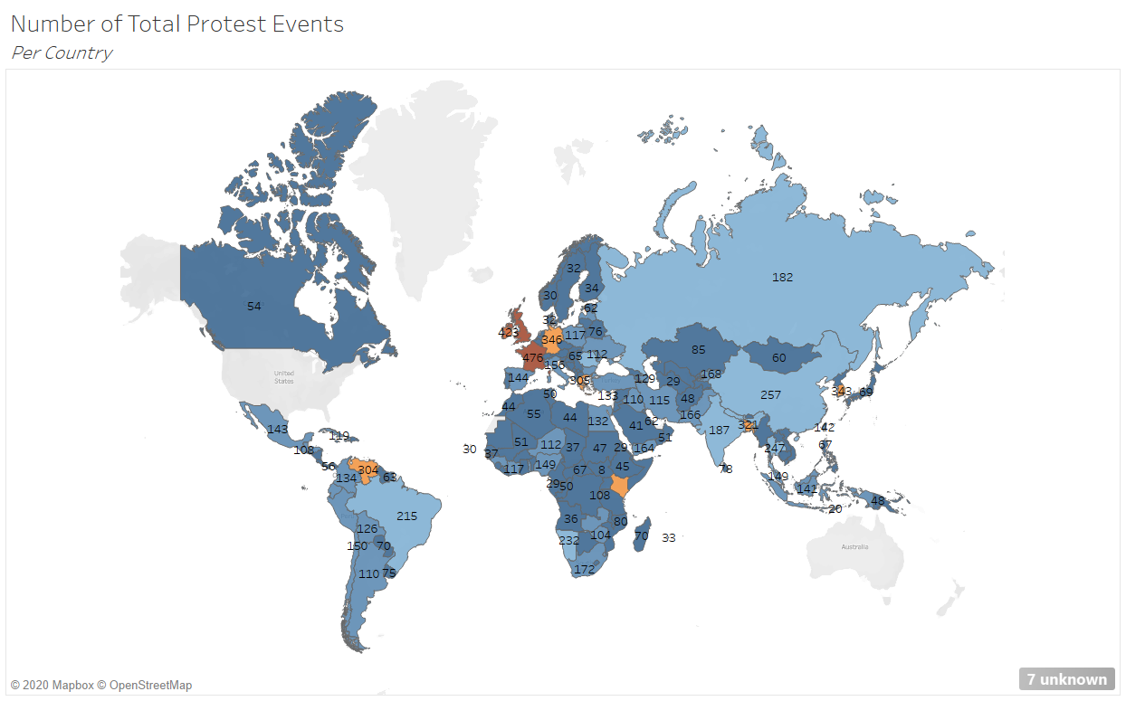
Global Distribution of Protests
The Top 5 countries with the highest numbers of protests are: United Kingdom, France, Ireland, Kenya, and Germany. In comparison to the UK’s 528 events, India witnessed 187 organized protests while Canada had members march in 54 separate events.

Slide 5
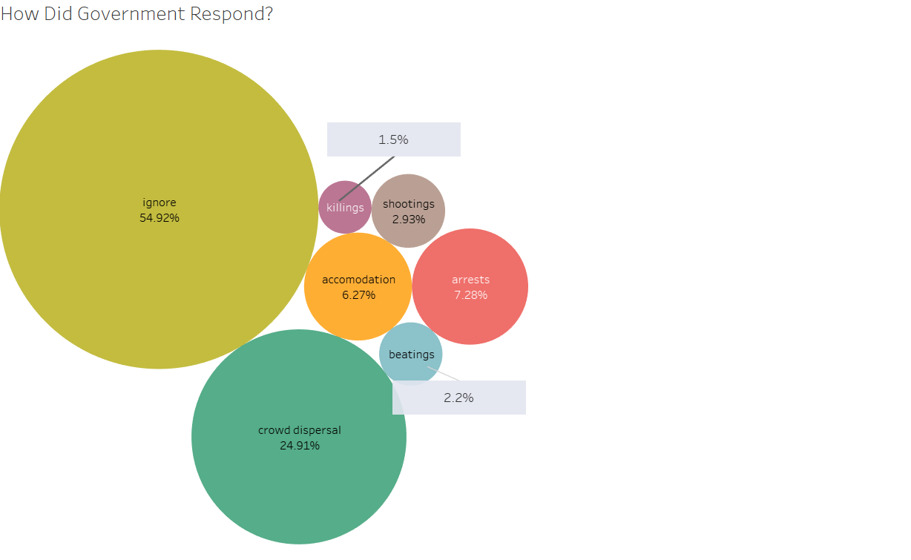
How Did Authorities Respond?
There are many ways for authorities to respond to a protest. In our dataset, they chose to ignore just over 50% of the events. Note: News outlets could have not reported on the event in more extreme regimes (i.e. censoring).
In 6% of the protests resulted in accommodating the social movement, such as: reports that the authorities met with protest leadership; that the demand was met or that the authorities agreed to take the protester demands up in a formal meeting.

Slide 6
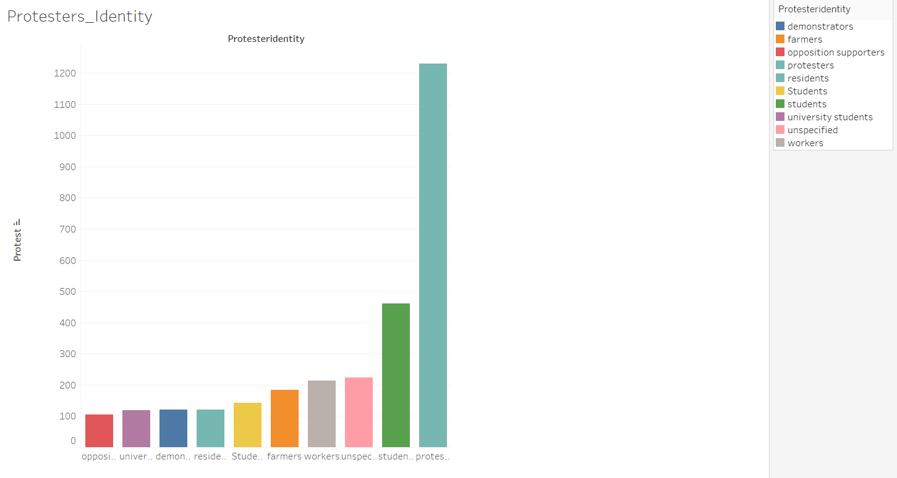
Who is Protesting?

Slide 7
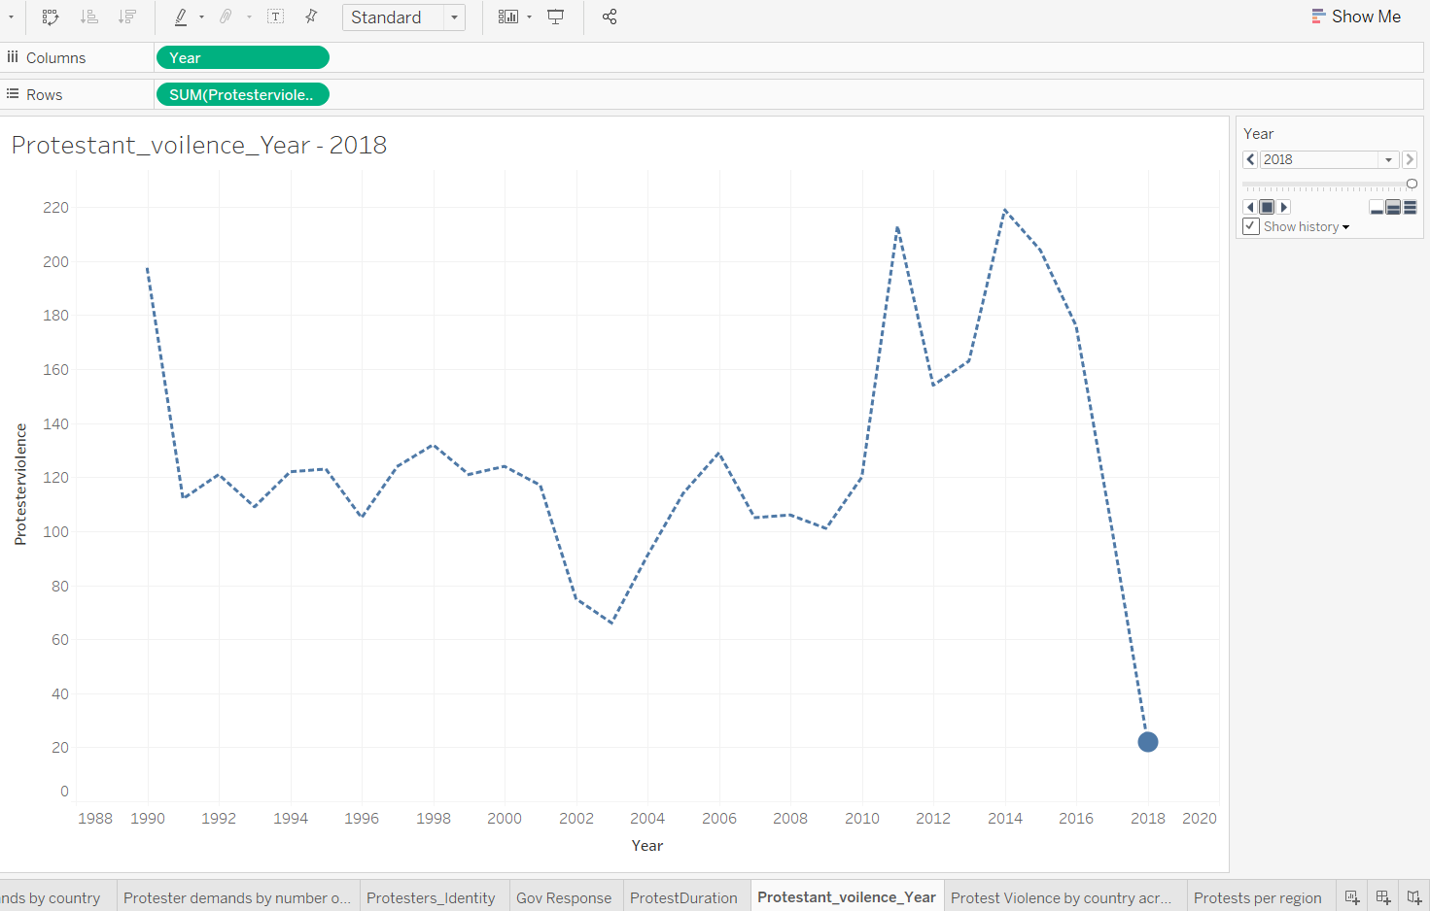
Protests Over The Years

Slide 8
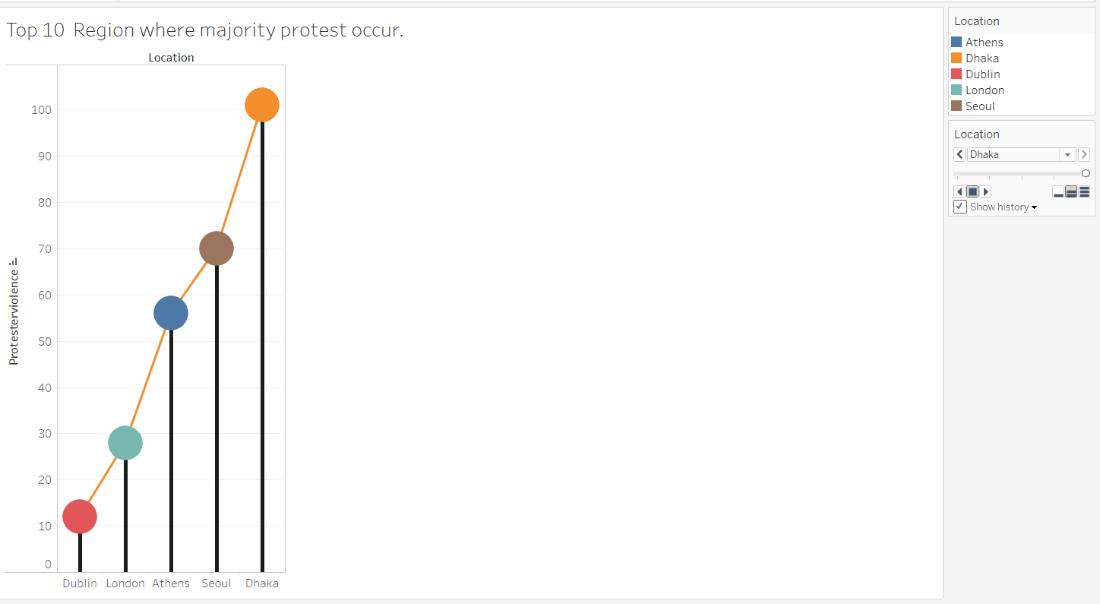
Violence in Protesting
This visualization shows whether protesters engaged in violence against the state. The violence could include anything from riotous behavior that destroys property to shooting at the police or military.

Slide 9
Conclusion
Governments can address the historical concern of exploitation that emerge from social movements by analyzing this data.
Authorities in the UK and Eurozone area should listen more closely to grassroots leaders, as citizens in those countries are more apt to protest. The government in Dhaka within Bangladesh, should be cognizant that protests in their area results in the most amount of violence.
Lastly, all government officials and policy makers should reach out to students, as they number the highest group that is prone to protesting.
By focusing on students, areas prone to violence, and areas more eager to protest, many lives can be saved and economic disruptions avoided.

Slide 10
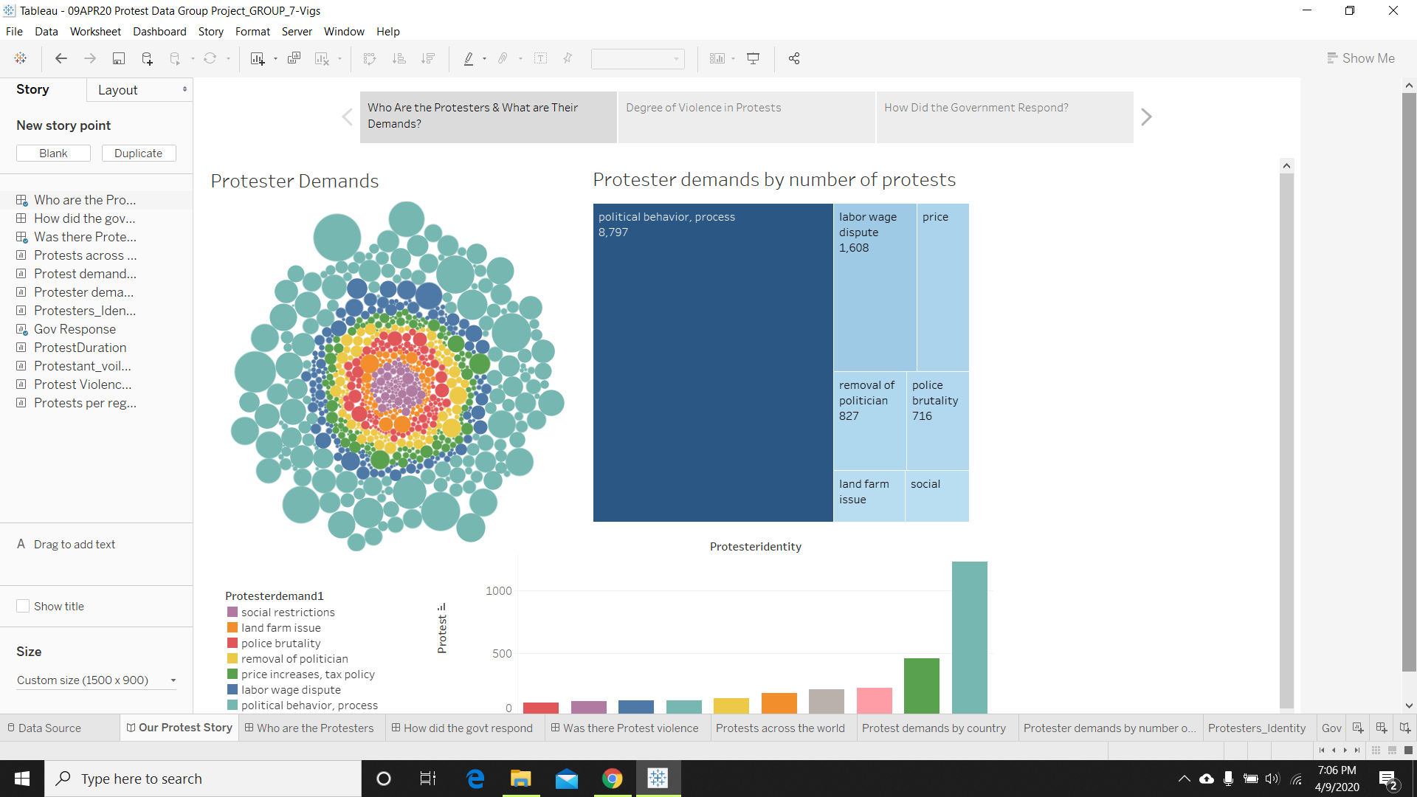
Our Tableau Story - Demonstration

